Slide 1
EE1004
Fndt'n of IS & Data Anlys
Andrew Leung : eeleungc@cityu.edu.hk
Whatsapp
852-90872682

Slide 2
Chapter One
What are data?
What is “big data”?
The ways to represent data in engineering

Slide 3

What are data?
Data are raw facts and figures that on their own have no meaning
Data are gathered or captured(捕获) from activity of people, places and things.
These can be any alphanumeric(字母数字) characters i.e. text, numbers, symbols

Slide 4
What are data?
Answers of a questionnaire:
Yes, Yes, No, Yes, No, Yes, No, Yes
42, 63, 96, 74, 56, 86
111192, 111234
None of the above have any meaning until they are given a CONTEXT and PROCESSED into a usable form
What is the value of 1100 ??
The correct answer is “I do not know” because no context is given.
You want to be good in study. Please do not be loose-loose.

Slide 5

Qualitative and Quantitative
Example 1: My Dog
Qualitative:
He is ``white and brown’’
data value is ``white and brown’’
context is hair color of my dog
Hair color is Qualitative data(定性数据)
His breed is corgi
Quantitative(定量的):
Discrete:
Legs : 4 (context is number of legs, data value is 4, …)
Continuous:
He weighs 5.2 kg (context is what??)
P

Slide 6

Context
Example 2: My network
Qualitative:
Color of desktop : black
Network protocol: TCP
Structure : Star
Quantitative:
Discrete:
Number of desktop : 8
Servers : 1
Continuous:
Power consumption: 20.28 KW
Total Cable length: 200.25 m
P

Slide 7
Qualitative and Quantitative
Summary:
Qualitative Data | Quantitative Data
Deals with descriptions Data can be observed Colors, texture type, smells, beauty, etc. | Result of counting or measuring attributes of a population. Deals with numbers Data which can be measured. Length, height, area, power consumption
P

Slide 8
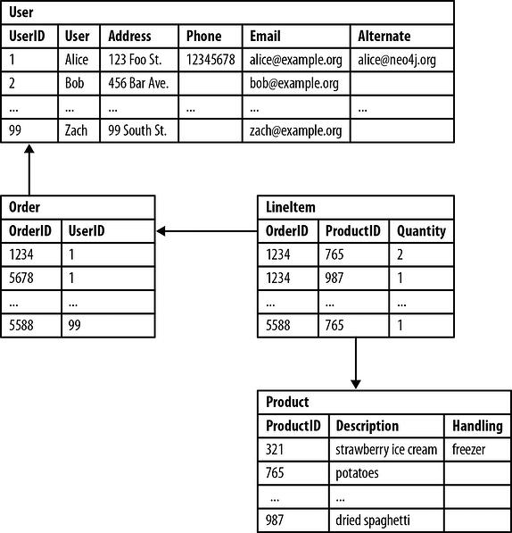
Structured Data and Unstructured Data
Structured data is the type of data most of us are used to working with. Think of data that fits neatly within fixed fields and columns in relational databases and spreadsheets. Hence structured data the patterns of structured data make them easily searchable.
Fields store length-delineated data phone numbers, Social Security numbers, or ZIP codes. Even text strings of variable length like names are contained in records, making it a simple matter to search.
Note that in a database, the format(格式) of a field is well defined.
Data may be human- or machine-generated.
Their formats allow us to search with human generated queries and via algorithms(算法) using type of data and field names, such as alphabetical(字母) or numeric(数字), currency(货币) or date.
P

Slide 9

Structured Data and Unstructured Data
Unstructured data is “everything else” – is comprised of data that is usually not as easily searchable, such as a collection of audio files, video files, and social media postings, formats of data should be different.
Unstructured data has internal structure but is not structured via pre-defined data models or schema. It may be textual or non-textual, and human- or machine-generated. It may also be stored within a non-relational database like NoSQL.
P

Slide 10
Structured Data and Unstructured Data
Typical human-generated unstructured data includes:
Text files: Word processing, spreadsheets, presentations, email, logs.
Emails: Email has some internal structure thanks to its metadata, and we sometimes refer to it as semi-structured. However, its message field is unstructured and traditional analytics tools cannot parse it.
Social Media files: Data from Facebook, Twitter, LinkedIn.
Websites: YouTube, Instagram, photo sharing sites.
Typical machine-generated unstructured data includes:
Satellite imagery(卫星图像): Weather data, land forms, military movements.
Scientific data: Oil and gas exploration, space exploration, seismic imagery, atmospheric data.
Sensor data: Traffic, weather, oceanographic sensors.
P

Slide 11
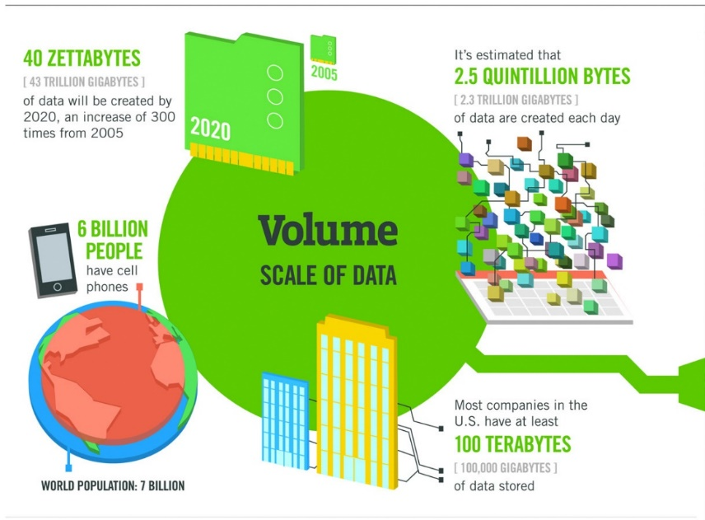
Big Data
Big Data is typically characterized by the following four V’s:
Volume体积:
The amount and scale规模 of data are very large compared to traditional data sources we had in the past.
facebook posts, and Youtube, DNA record
Usually greater than terabytes and petabytes
The data sets in Big Data are too large to process with a regular laptop or desktop processor.
P

Slide 12
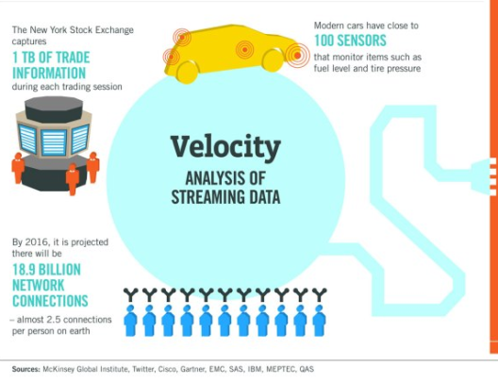
Big Data
Velocity: (generation speed of daa)
Data are generated extremely fast, the process that never stops even while we sleep. Storing them never stops too.
Single instance of high-velocity data is Twitter where over 350,000 tweets are now sent worldwide per minute, equating to 500 million tweets per day.
Do you the difference between volume and velocity?
What is the situation that we have high volume but low velocity ?
P

Slide 13
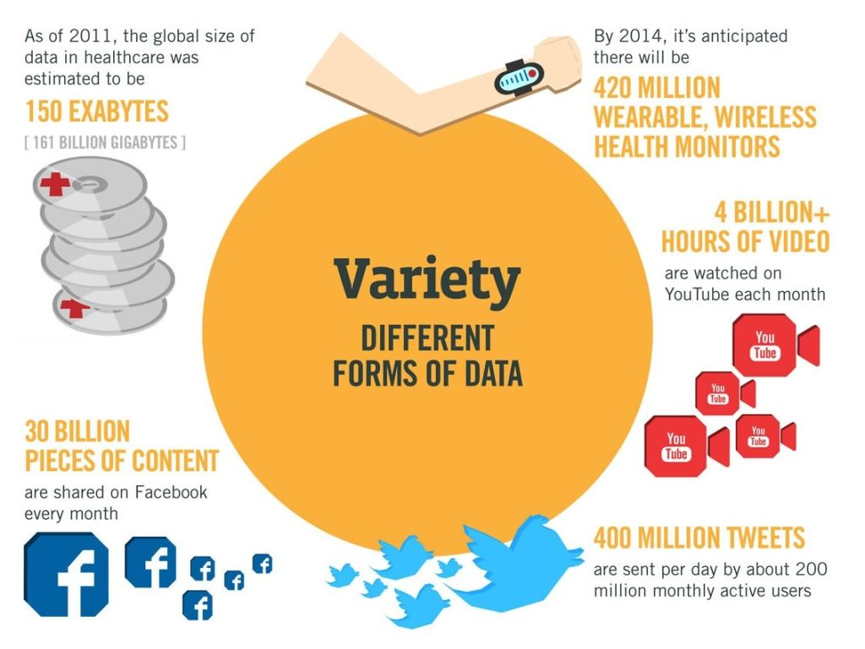
Big Data
Variety
The data comes from different sources in different structures and forms. Data are created not only by human but also by machines.
Three types: structured, semi structured and unstructured data.
The variety in data types implies that we need particular processing capabilities能力 and specialist algorithms.专业算法
CCTV audio and video files at various locations in a city.
Facebook images and videos
P

Slide 14
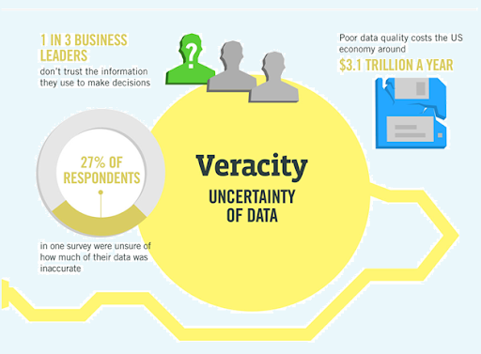
Big Data (Quality of Data)
Veracity:
Big Data come from many different places.
We need to test the quality of the data.
Data veracity, in general, is how accurate or truthful a data set may be. In the context of big data, however, it takes on a bit more meaning.
It's not just the quality of the data itself but how trustworthy the data source, type, and processing of it is.
P

Slide 15
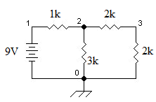
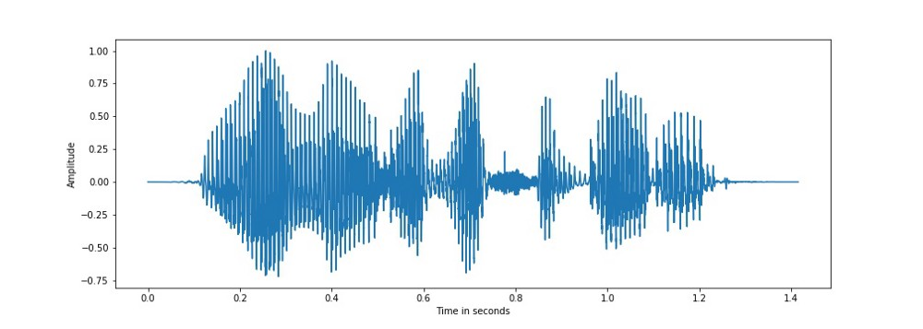

Representation of Data in EE (common EE Eng data)
Circuits:
$9={1000×i}_{1}+{4000×i}_{2}$
$9={1000×i}_{1}+{3000×i}_{3}$
$0=i_{1}−i_{2}−i_{3}$
Signals: Speech signal, image
In EE, we usually use some mathematic objects to describe the physical things.
To have a good study in EE, we need to know and understand the meaning of
the mathematic objects.
P

Slide 16
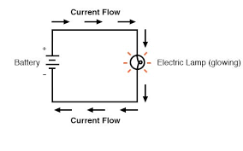
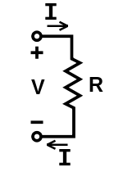
Representation of Data in EE
Circuit:
Ohm’s law :
Ohm's law states that the current through a conductor between two points is directly proportional to the voltage across the two points.
Voltage=Current × Resistance
V=IR
Voltage: electric potential difference.
Current: the rate of flow of electric charge (electrons) past a point.
Resistance: a measure of its opposition to the flow of electric current.
P

Slide 17
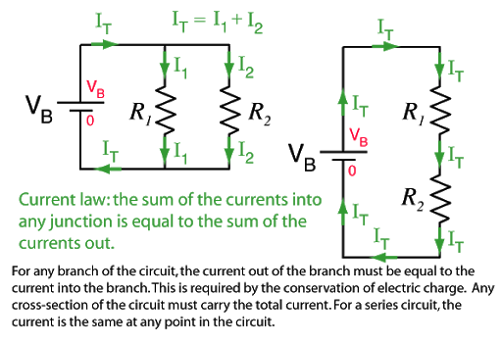
Representation of Data in EE
Circuit:
Notations: Circuit Diagrams
Node: Point of connection between elements.
Branch : Connection between two nodes.
Loop: Closed loops in circuit diagram.
P

Slide 18

Representation of Data in EE
Kirchhoff's Current Law
Algebraic sum of currents entering a closed a node (or a loop) is zero. (note that currents have directions)
$$\sum{i_{n}}=0$$
P

Slide 19
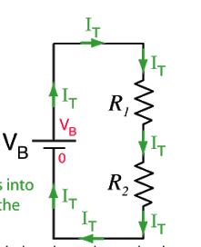

Representation of Data in EE
Kirchhoff's Voltage Law
Algebraic sum of all voltages around a closed path (or loop) is zero.
$$\sum{V_{n}}=0$$
$V_{B}−I_{T}R_{1}−I_{T}R_{2}=0$
P

Slide 20
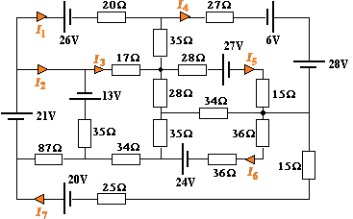
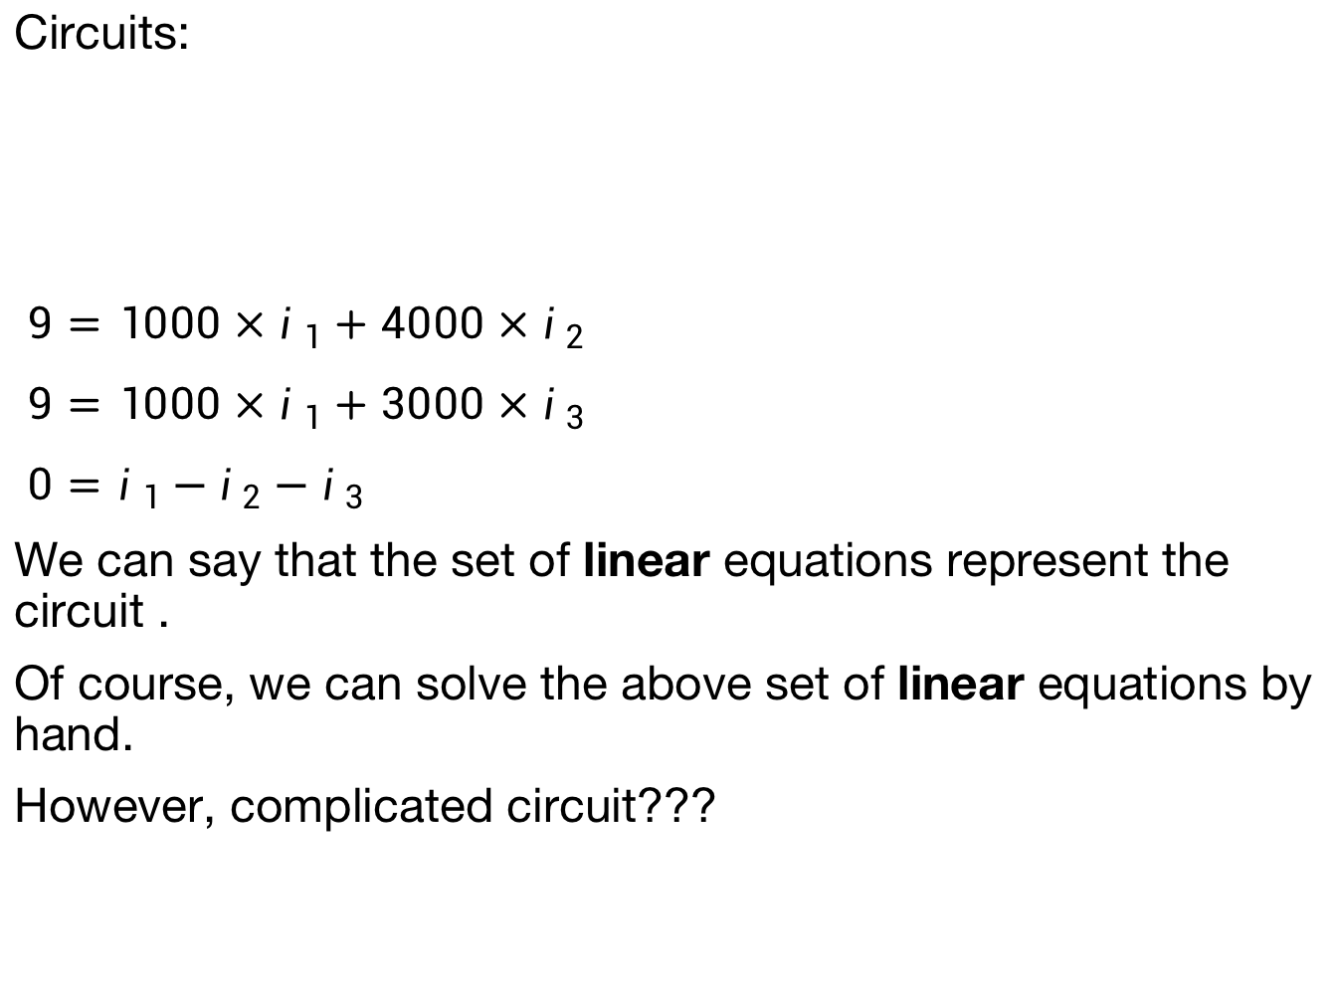
Representation of Data in EE
Circuits:
$9={1000×i}_{1}+{4000×i}_{2}$
$9={1000×i}_{1}+{3000×i}_{3}$
$0=i_{1}−i_{2}−i_{3}$
We can say that the set of linear equations represent the circuit .
Of course, we can solve the above set of linear equations by hand.
However, complicated circuit???
Many students may set up inappropriate equations. three cases: wrong equations, not enough equations, some equations are not linear independent
P

Slide 21
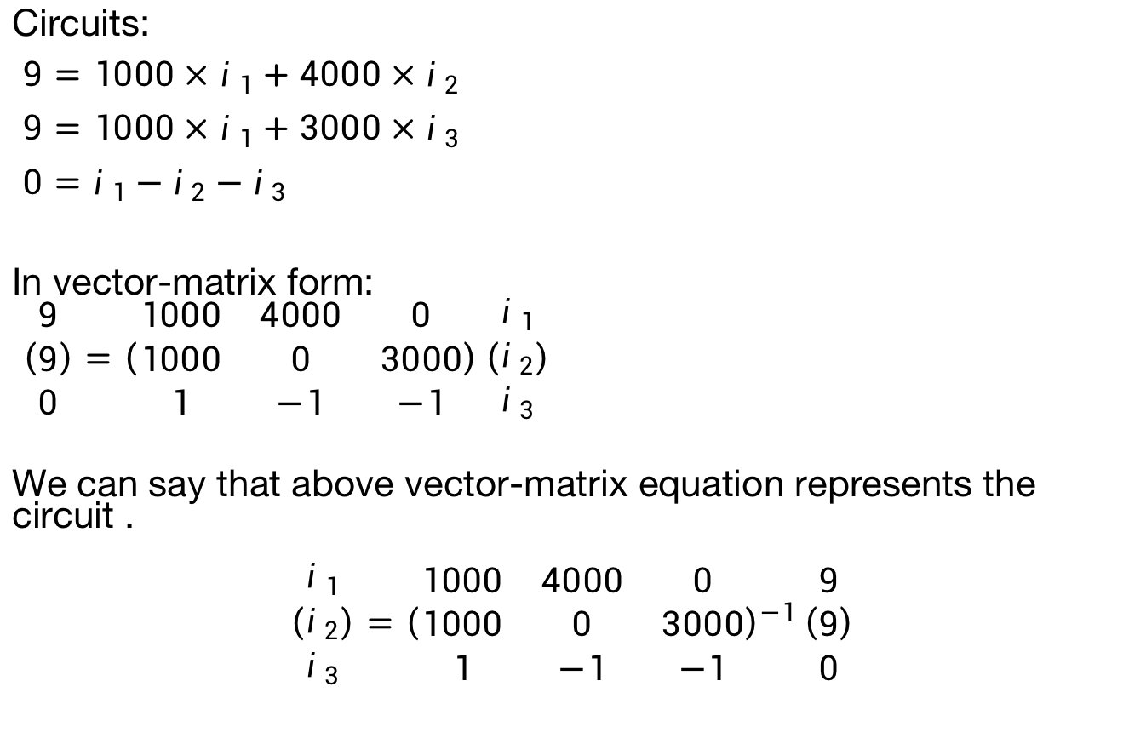
Representation of Data in EE
Circuits:
$9={1000×i}_{1}+{4000×i}_{2}$
$9={1000×i}_{1}+{3000×i}_{3}$
$0=i_{1}−i_{2}−i_{3}$
In vector-matrix form:
$\left(\begin{matrix}9 \\ 9 \\ 0\end{matrix}\right)=\left(\begin{matrix}1000 & 4000 & 0 \\ 1000 & 0 & 3000 \\ 1 & −1 & −1\end{matrix}\right)\left(\begin{matrix}i_{1} \\ i_{2} \\ i_{3}\end{matrix}\right)$
We can say that above vector-matrix equation represents the circuit .
$$\left(\begin{matrix}i_{1} \\ i_{2} \\ i_{3}\end{matrix}\right)={\left(\begin{matrix}1000 & 4000 & 0 \\ 1000 & 0 & 3000 \\ 1 & −1 & −1\end{matrix}\right)}^{−1}\left(\begin{matrix}9 \\ 9 \\ 0\end{matrix}\right)$$
P

Slide 22
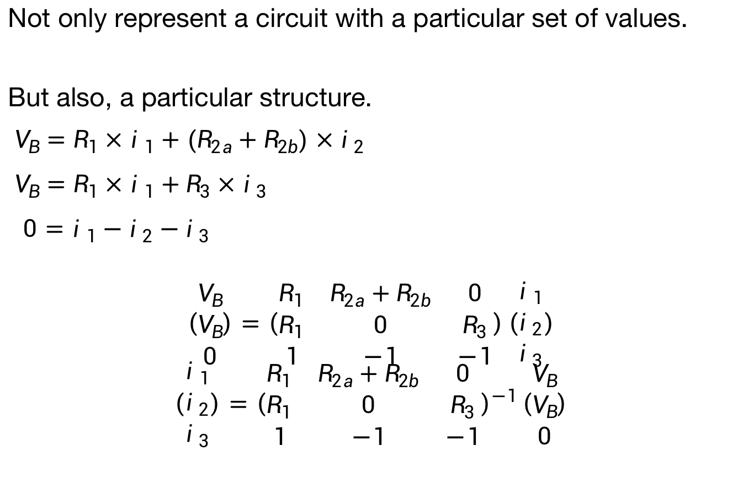
Representation of Data in EE
Not only represent a circuit with a particular set of values.
But also, a particular structure.
$V_{B}={R_{1}×i}_{1}+{(R_{2a}+R_{2b})×i}_{2}$
$V_{B}={R_{1}×i}_{1}+{R_{3}×i}_{3}$
$0=i_{1}−i_{2}−i_{3}$
$$\left(\begin{matrix}V_{B} \\ V_{B} \\ 0\end{matrix}\right)=\left(\begin{matrix}R_{1} & R_{2a}+R_{2b} & 0 \\ R_{1} & 0 & R_{3} \\ 1 & −1 & −1\end{matrix}\right)\left(\begin{matrix}i_{1} \\ i_{2} \\ i_{3}\end{matrix}\right)$$
$$\left(\begin{matrix}i_{1} \\ i_{2} \\ i_{3}\end{matrix}\right)={\left(\begin{matrix}R_{1} & R_{2a}+R_{2b} & 0 \\ R_{1} & 0 & R_{3} \\ 1 & −1 & −1\end{matrix}\right)}^{−1}\left(\begin{matrix}V_{B} \\ V_{B} \\ 0\end{matrix}\right)$$
P

Slide 23
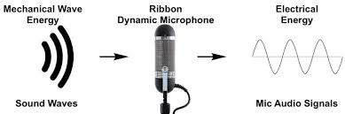
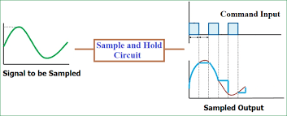
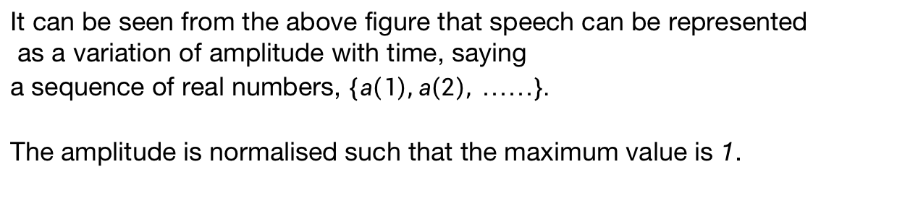
Representation of Data in EE
Speech
It can be seen from the above figure that speech can be represented
as a variation of amplitude with time, saying
a sequence of real numbers, $\left\{a\left(1\right),a\left(2\right), ……\right\}.$
The amplitude is normalised such that the maximum value is 1.
P

Slide 24

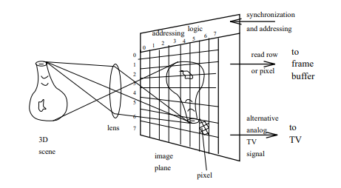
Representation of Data in EE
Image
A grey scale image is a monochrome digital image Im[indx,indy] with
one intensity value per pixel. The indices indx and indy indicate the
positions of pixels.
A color image is a 2D image M[indx,indy,c], i.e., 2D array of 3D vectors, where c=1 to 3. Or say 3D array.
In image processing and pattern recognition, we use a lot of mathematics tools in linear algebra to handle those arrays.
P

